Slide 1
Building an LLM on Your Local Machine with GPT-1 and GPT-2

Slide 2
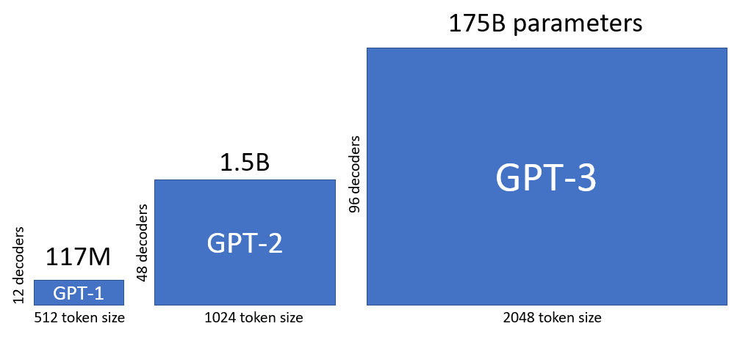
Introduction
What are Language Models (LMs)?
LMs are AI tools trained to read, understand, and generate human-like text.
They predict the next word in a sentence, making them useful for tasks like content generation, summarization, and translation.
Why GPT-1 and GPT-2?
GPT-1 (2018): Introduced foundational techniques for transformer-based models.
GPT-2 (2019): Improved upon GPT-1 with significantly larger size and capabilities, making it better at generating realistic, coherent text.
Timeline

Slide 3
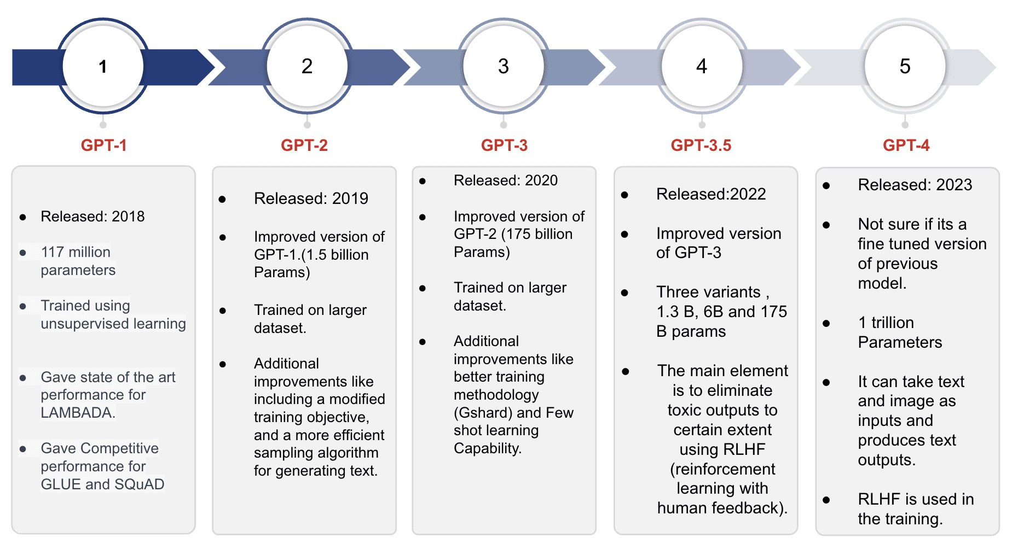
What are GPT’s?

Slide 4
Why Do We Need to Train Models?
Pre-trained models are generic:
GPT-1 and GPT-2 are pre-trained on large, general datasets (e.g., books, internet text).
They lack domain-specific knowledge for specialized tasks (e.g., medical reports, legal documents).
Fine-tuning makes models task-specific:
Training on your custom dataset teaches the model your specific vocabulary, tone, and content structure.
Examples: Writing poetry, generating financial reports, or medical diagnoses.
Improves Performance:
Fine-tuned models are more accurate for specific tasks.
Results in coherent, relevant, and actionable text generation.
Why Train Locally?
Full control over the training process.
Customization without sending sensitive data to third-party services.

Slide 5
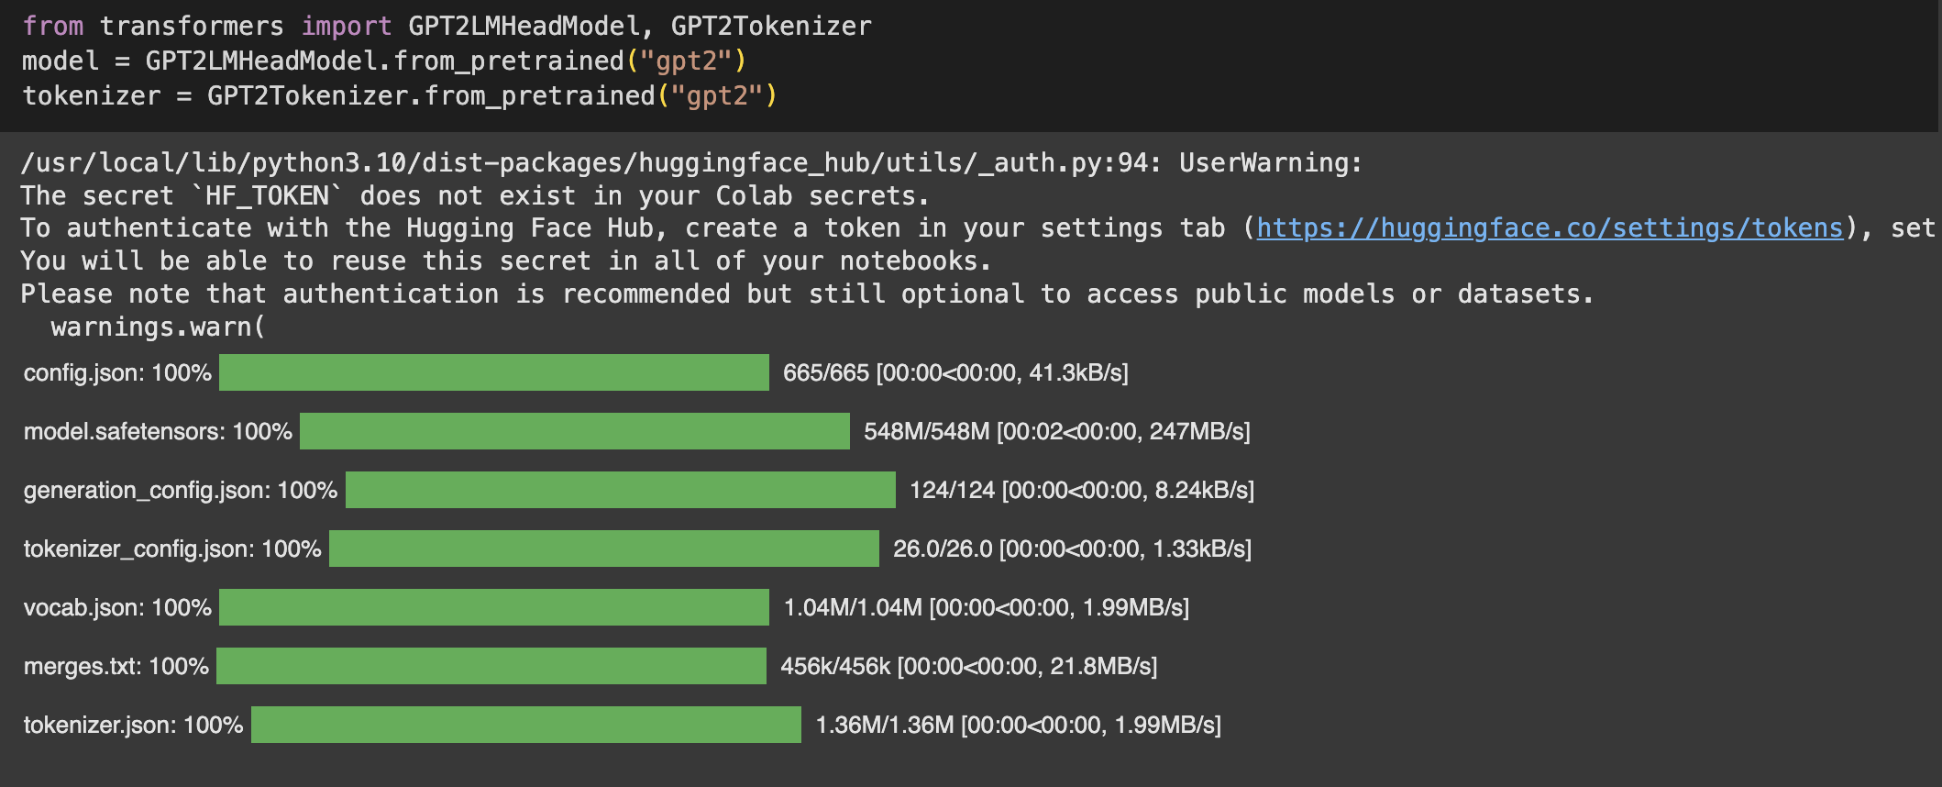
Downloading Pre-Trained Models
Pre-trained models like GPT-2 are already trained on massive datasets (e.g., books, internet articles).
This saves time and resources by providing a base model you can use directly or fine-tune.
To Download GPT-2 Using Hugging Face:

Slide 6
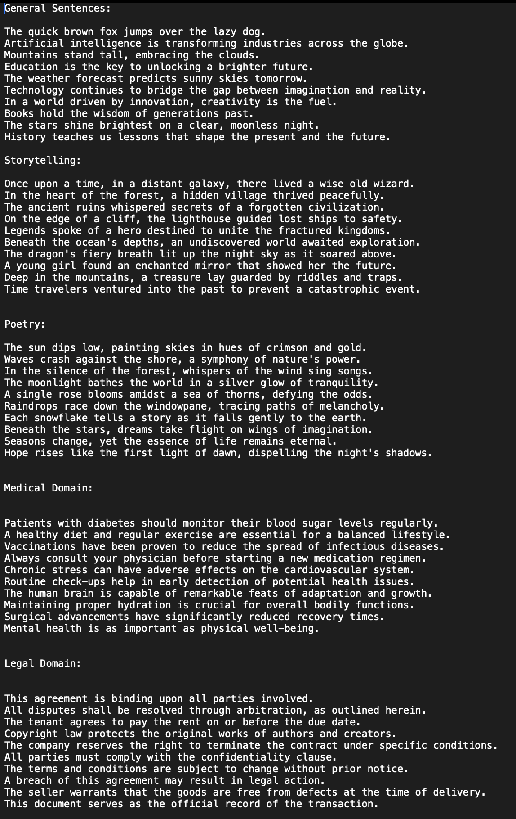
Fine-Tuning on Custom Data
Tokenization and Preprocessing:
Convert text into tokens the model can understand.
Clean the dataset to remove noise.
Fine-Tuning Process:
Used Hugging Face's Trainer API to train the model on the custom data.
Adjust hyperparameters (e.g., learning rate, epochs) for better results
Example Use Case:
Input: A text file containing poems, where each line is a structured poetic sentence.
Output: In the silence of the forest, whispers of the wind sing songs, A single rose blooms, defying the odds all along.

Slide 7
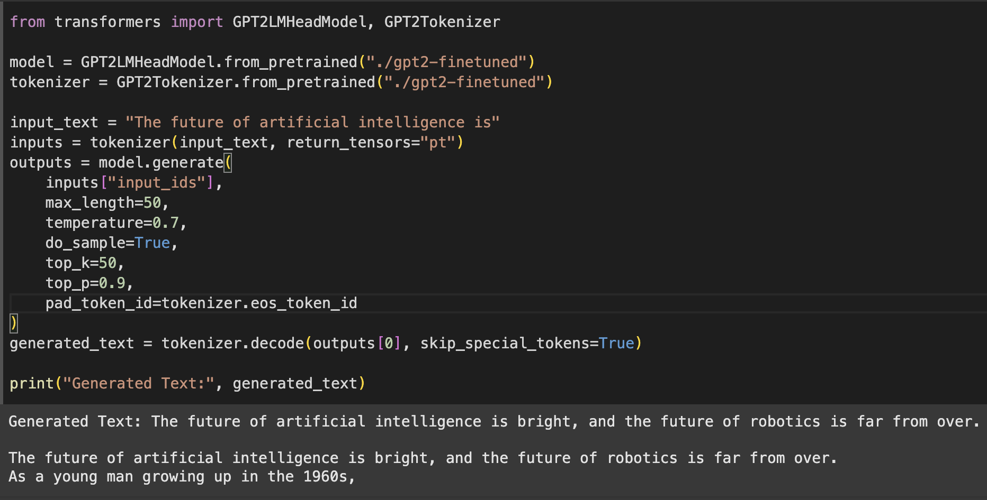
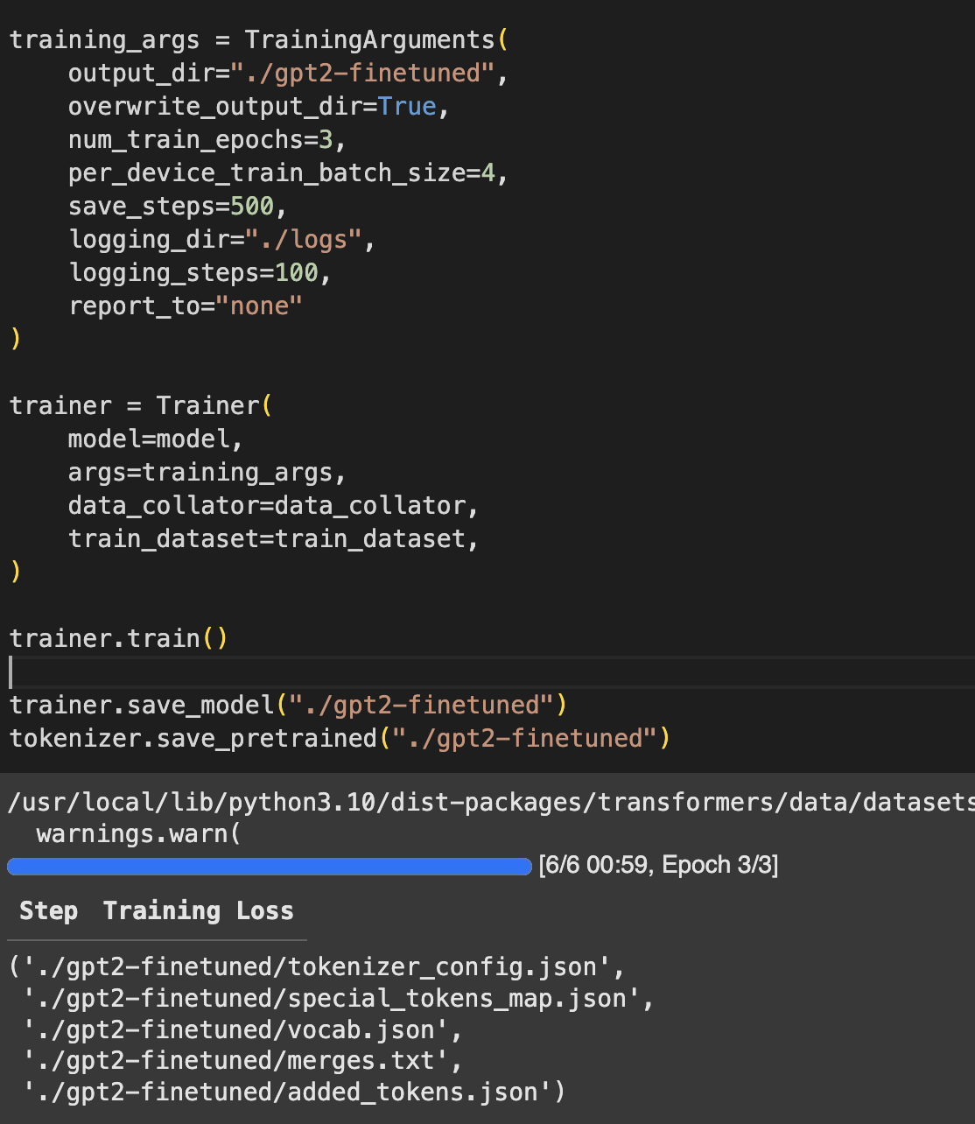
Fine-Tuning on Custom Data

Slide 8
Running GPT Locally
Using the Fine-Tuned Model Locally:
Once fine-tuned, the model can be used for various tasks like text generation or classification. We can load the fine-tuned model and tokenizer on your local machine and start making predictions.
Load the Fine-Tuned Model:
Use the Hugging Face library to load your saved model and tokenizer.
Use GPU Acceleration:
Running inference on an NVIDIA GPU with CUDA enabled can significantly speed up the process. This is important when working with large models or high volumes of data.
Batch Processing:
For efficiency, we can process multiple inputs in a single batch, which speeds up tasks like generating text for multiple prompts.

Slide 9
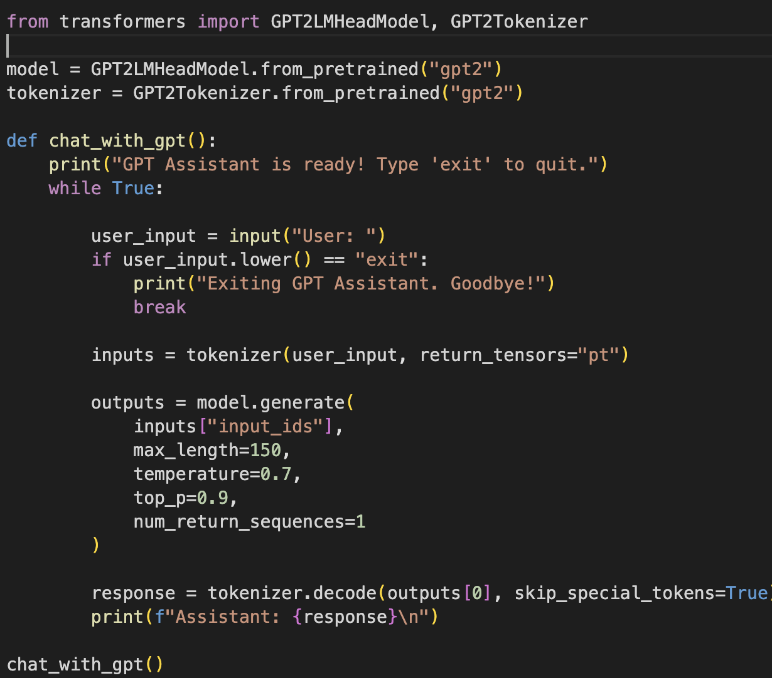
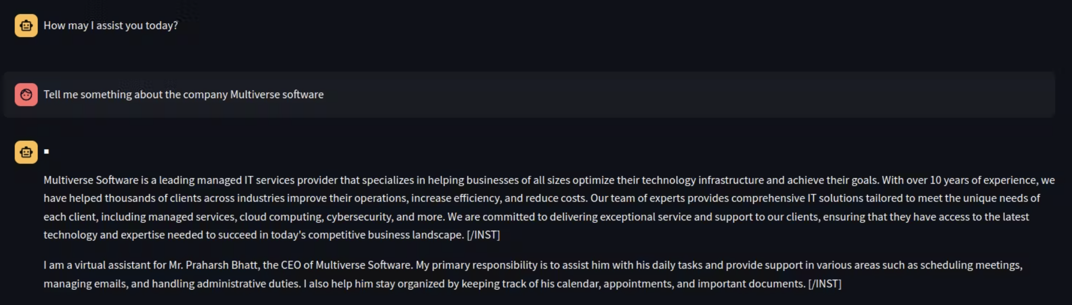

Slide 11
Thank you
—————————————————-
Questions ?

